Slide 1
The Bayesian Universe, Deep Learning and The Theory of Mind
An exploration of Computational Neuroscience

Slide 2
Probability
It is very certain that, when it is not in our power to determine what is true, we ought to act according to what is most probable.
René Descartes — Discours de la Méthode

Slide 3
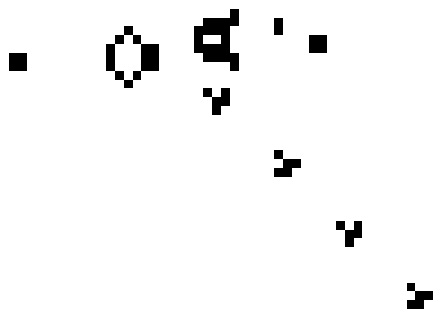

Interpretation Dispute
Objectivist
Subjectivist

Slide 4

Interpretation Dispute

Slide 5
The Bayesian Universe

Slide 6
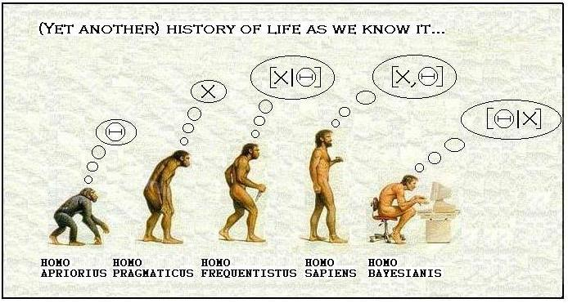
The Bayesian Interpretation

Slide 7

Bayesian Inference
$$P\left(E \right| H)=\frac{P\left(E \right| H)∙P(H)}{P(H)}$$

Slide 8
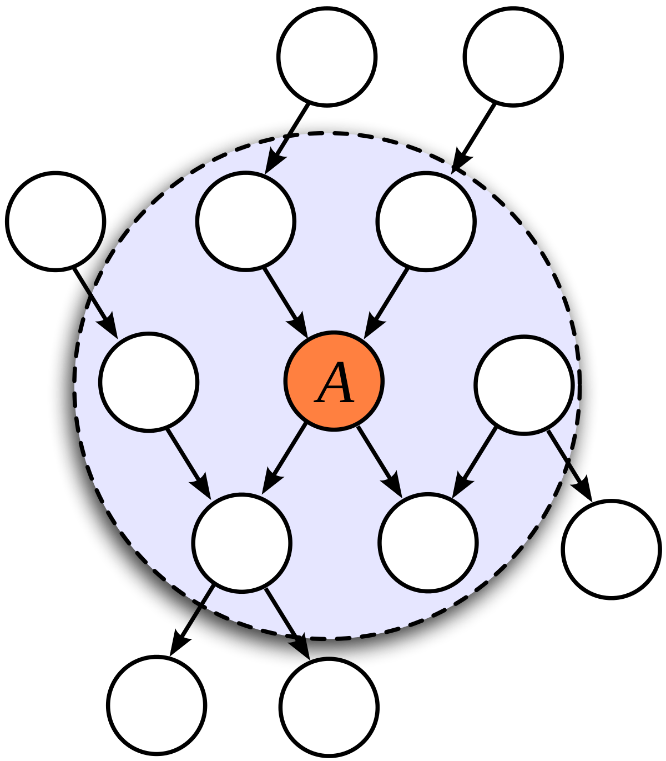
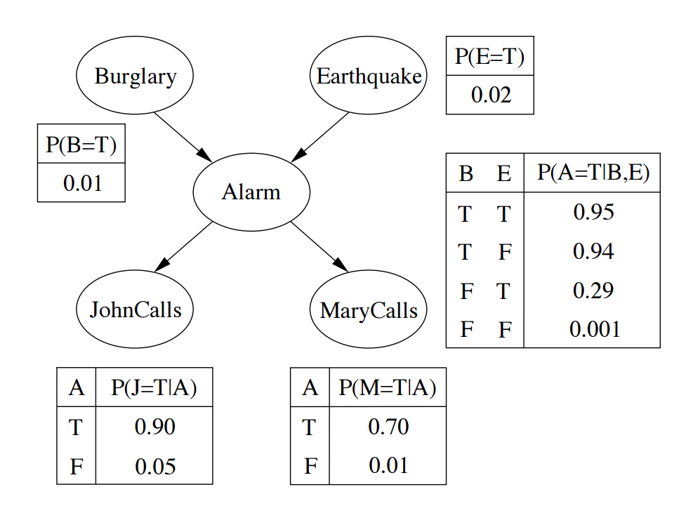
Bayesian Networks

Slide 9
Neural Networks

Slide 10
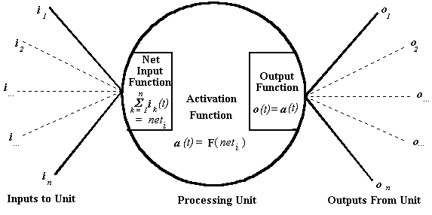
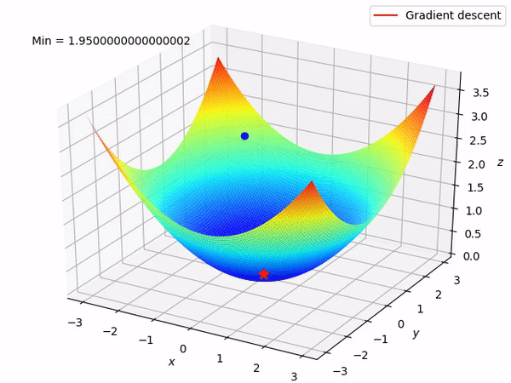
Connectionism

Slide 11
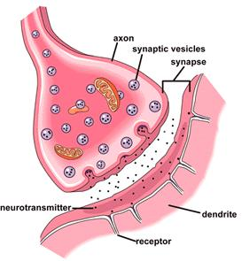
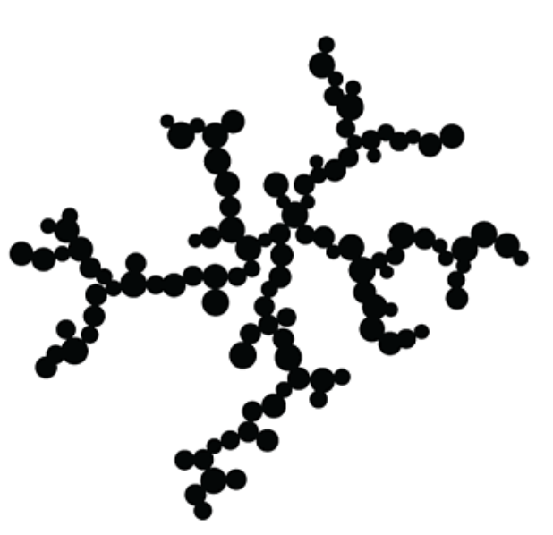
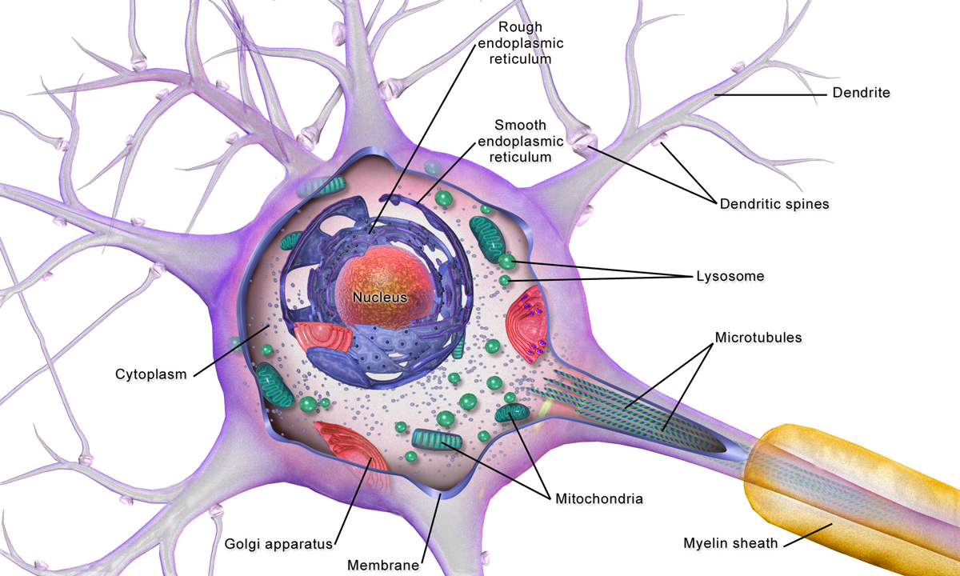
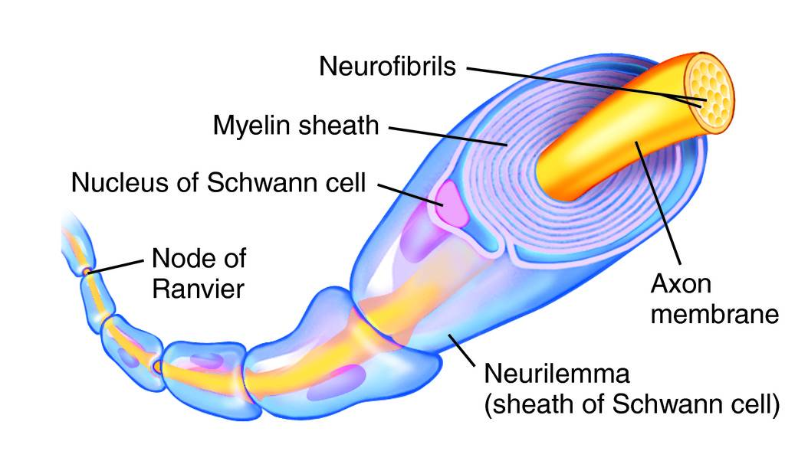
Biological Neural Networks
Synapse
Dendrite
Soma
Axon

Slide 12

Biological Neural Networks

Slide 13
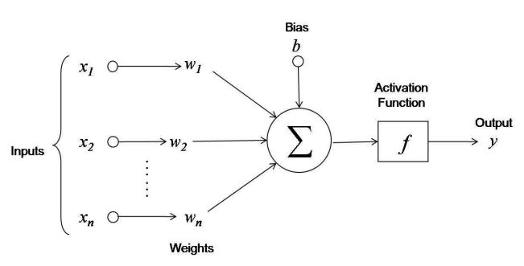



Artificial Neural Networks
Artificial Neuron
Activation Function
Backpropagation
$$y_{i}= φ\left(\sum_{j=0}^{n}{w_{ij}x_{j}}\right)$$
$$φ\left(x\right)=\frac{1}{1+ e^{−x}}$$
$$w_{ij}=w_{ij}+ η\frac{δC}{δw_{ij}}+ ξ$$

Slide 14
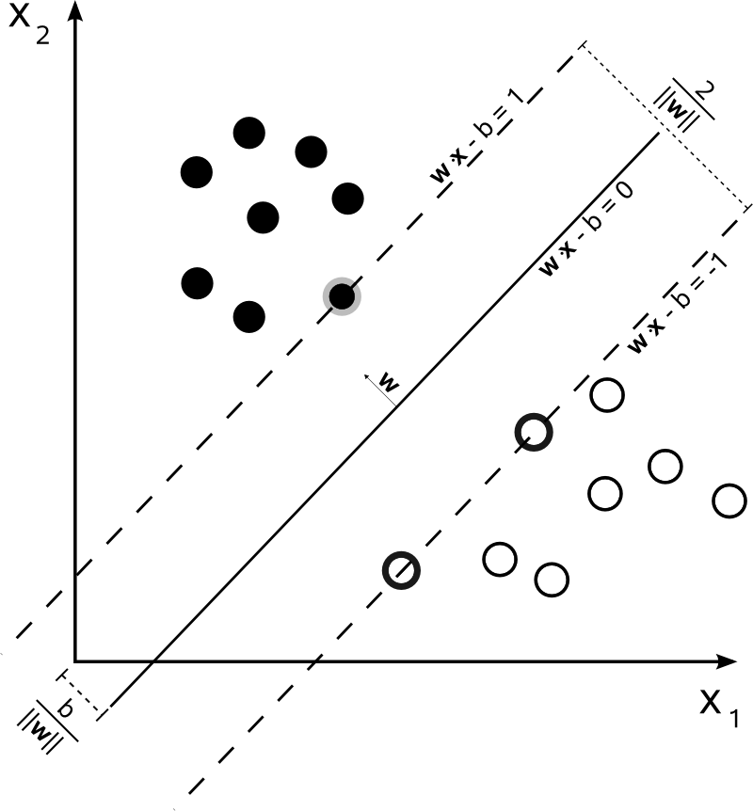


Paradigms of Learning
Supervised
Unsupervised
Reinforcement
$$V\left(s\right)=$$
$$\max_{a∈Γ(x)}\left\{F\left(s,a\right)+ βV(T\left(s,a\right))\right\}$$

Slide 15
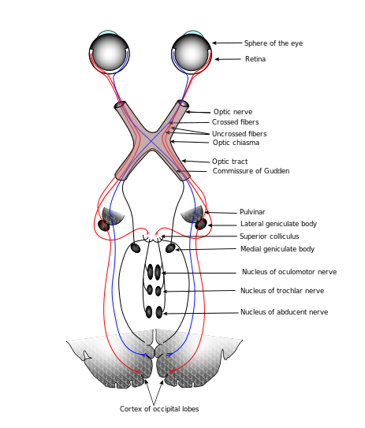
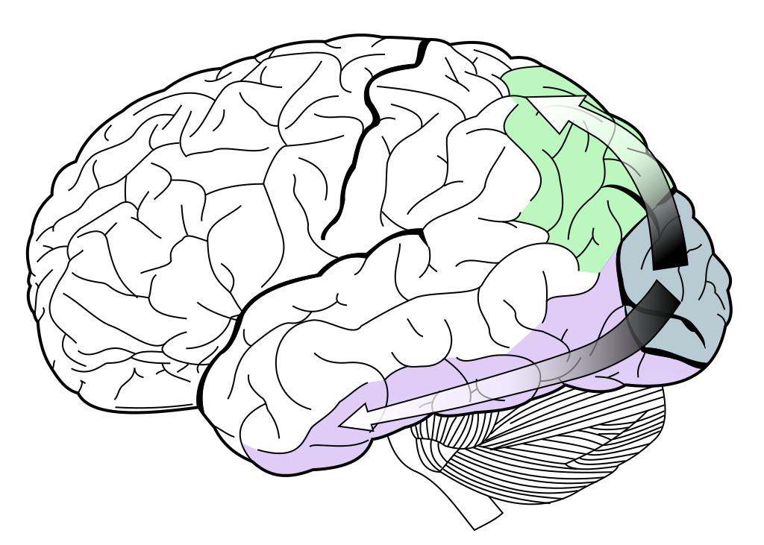
Convolutional Networks and the Human Visual System

Slide 16

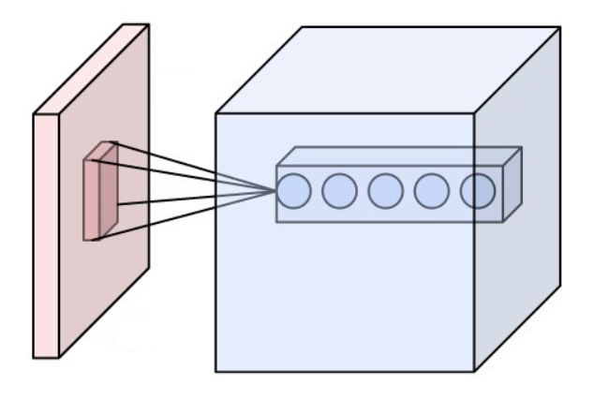
Convolutional Networks and the Human Visual System

Slide 17
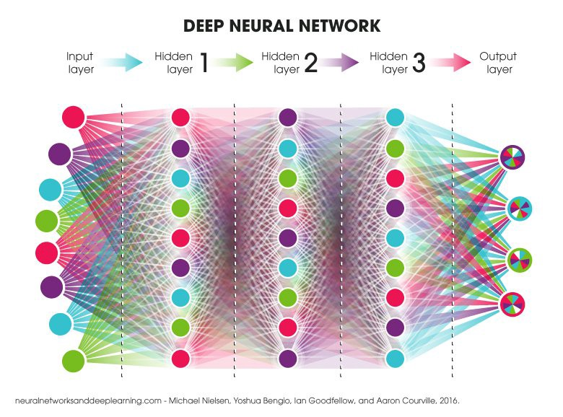

Deep Neural Networks
Universal Approximation Theorem
$$F\left(x\right)= \sum_{i=1}^{N}{v_{i}φ\left(w_{i}^{T}x+ b_{i}\right)}$$

Slide 18
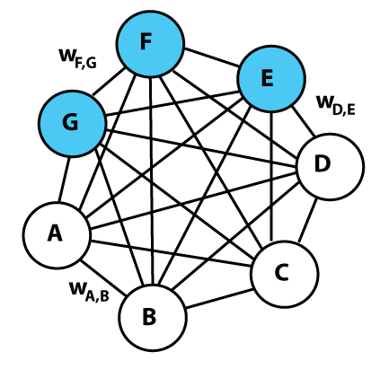
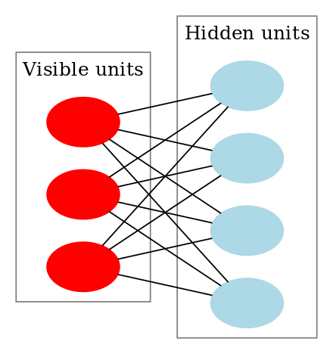


Boltzmann Machine
Energy of Network
$$E=−\left(\sum_{i<j}{w_{ij}s_{i}s_{j}}+ \sum_{i}{θ_{i}s_{i}}\right)$$
$$∆E_{i}= \sum_{j>i}{w_{ij}s_{j}}+ \sum_{j<i}{w_{ji}s_{j}}+ θ_{i}$$

Slide 19
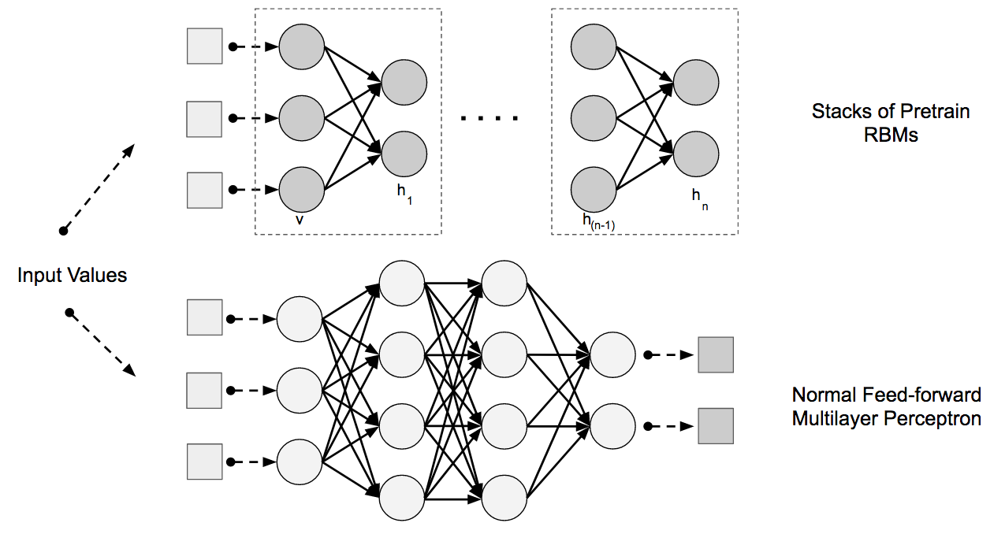
Deep Belief Networks

Slide 20
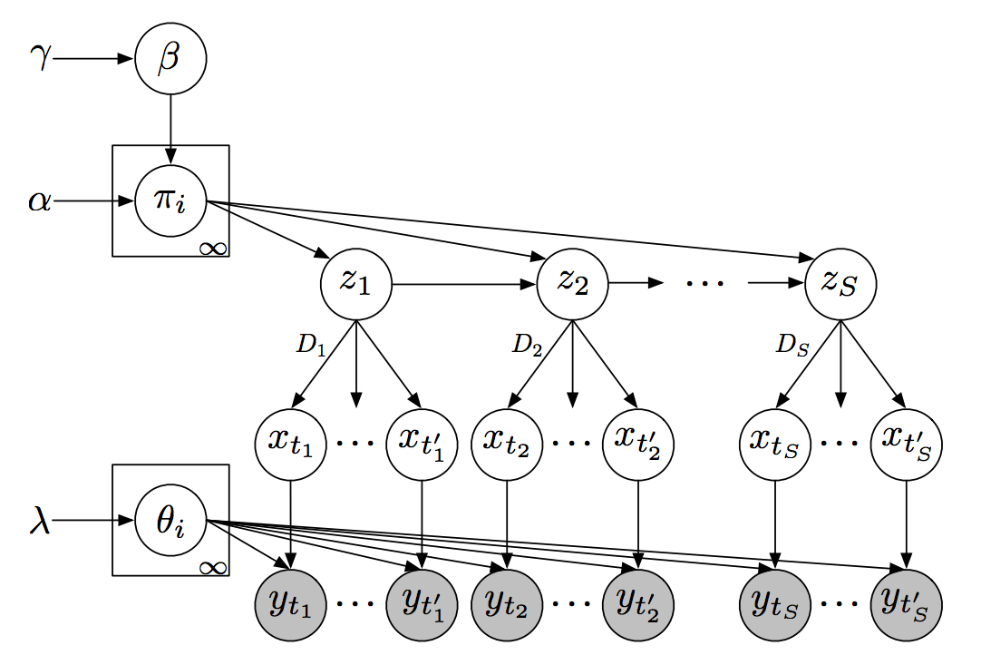
Compound Hierarchical-deep Models

Slide 21
Theory of Mind

Slide 22

Binding Problem

Slide 23
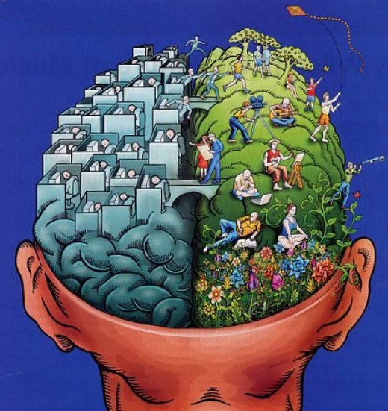
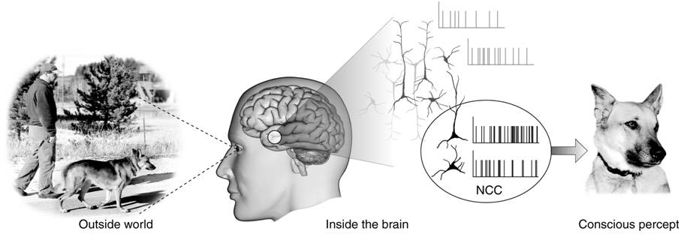
Mind-Body Problem

Slide 24
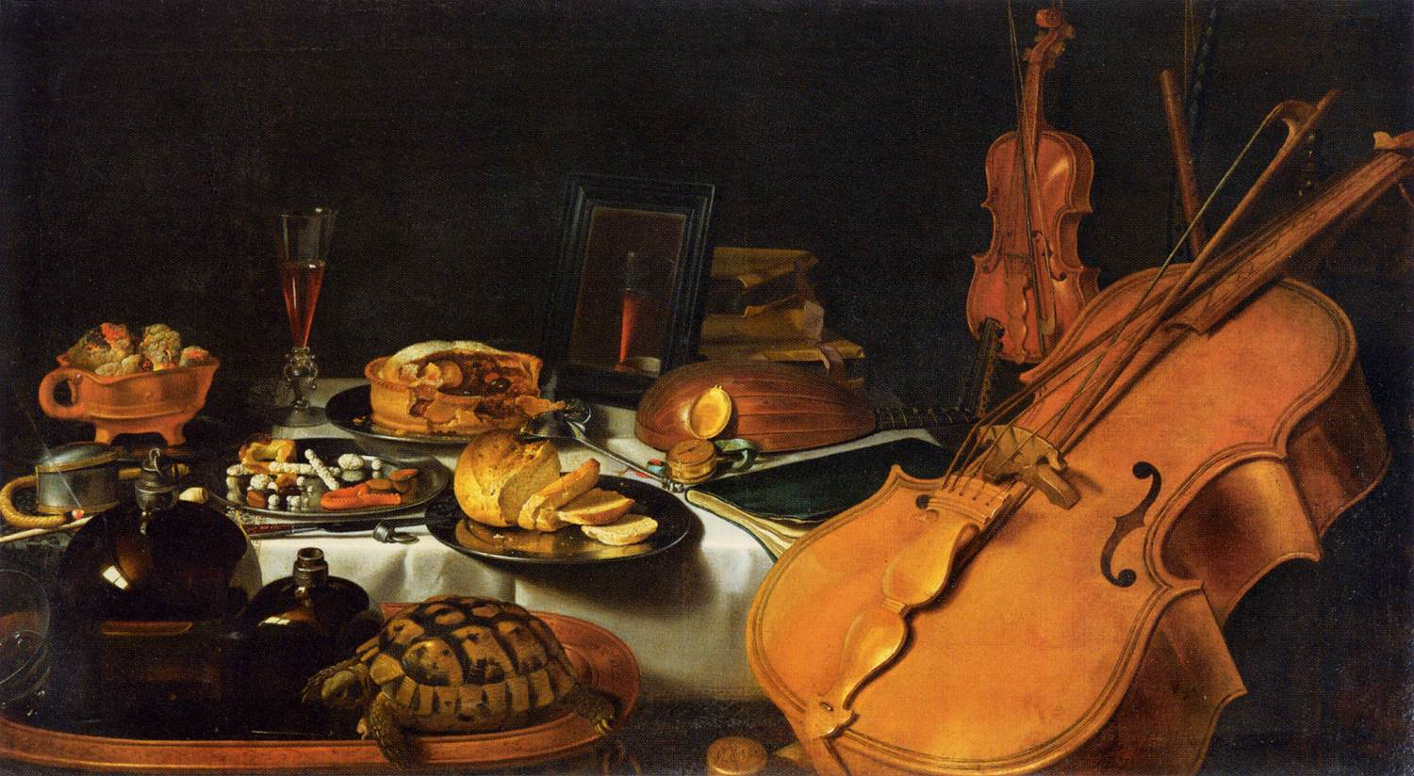
The Hard Problem of Consciousness

Slide 25
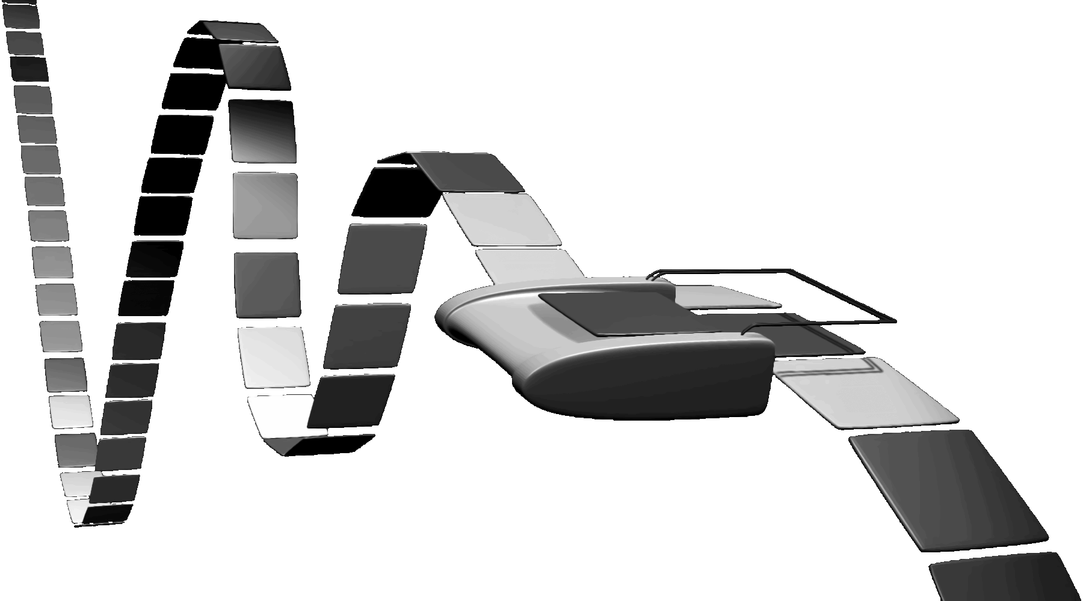
Functionalism

Slide 26

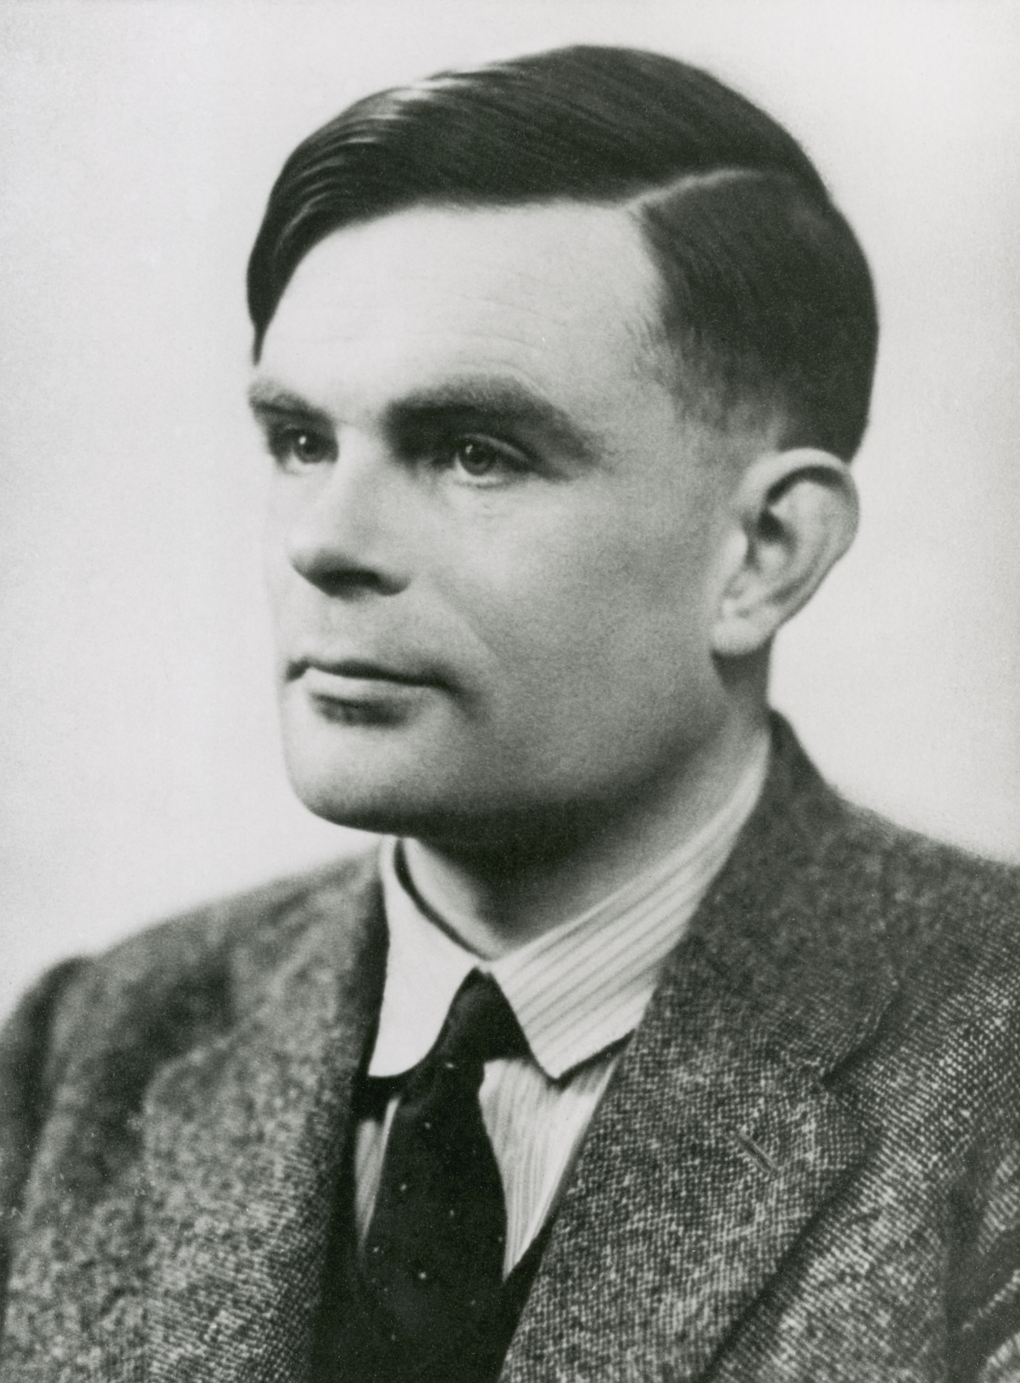
Turing Test

Slide 27
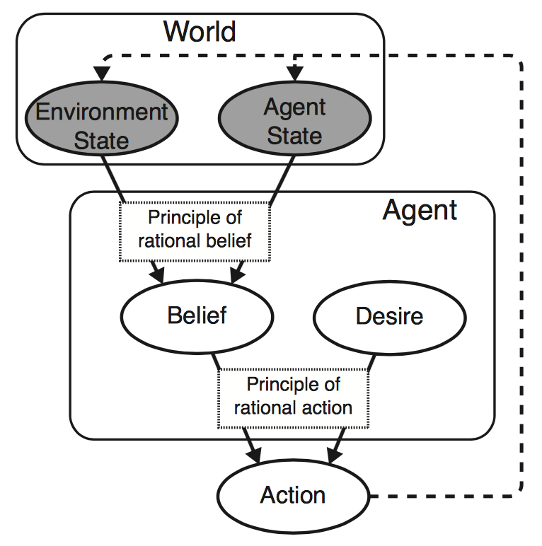
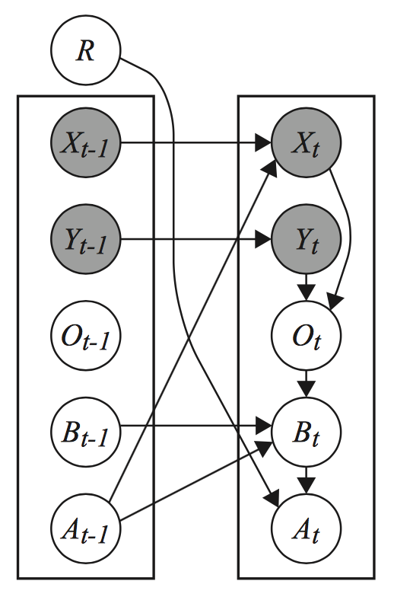
Bayesian Theory of Mind

Slide 28
Frontiers in Computational Neuroscience

Slide 29

AlphaZero and ‘Learning to Learn’

Slide 30

AlphaZero and ‘Learning to Learn’

Slide 31
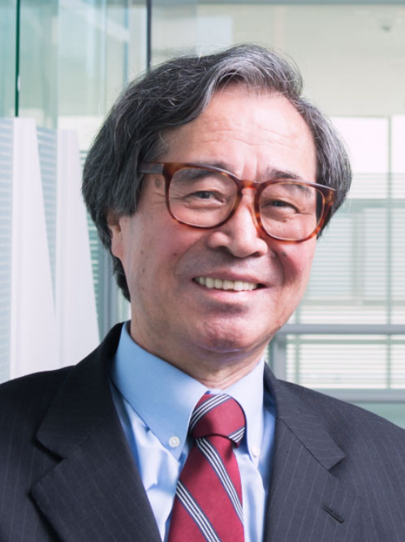
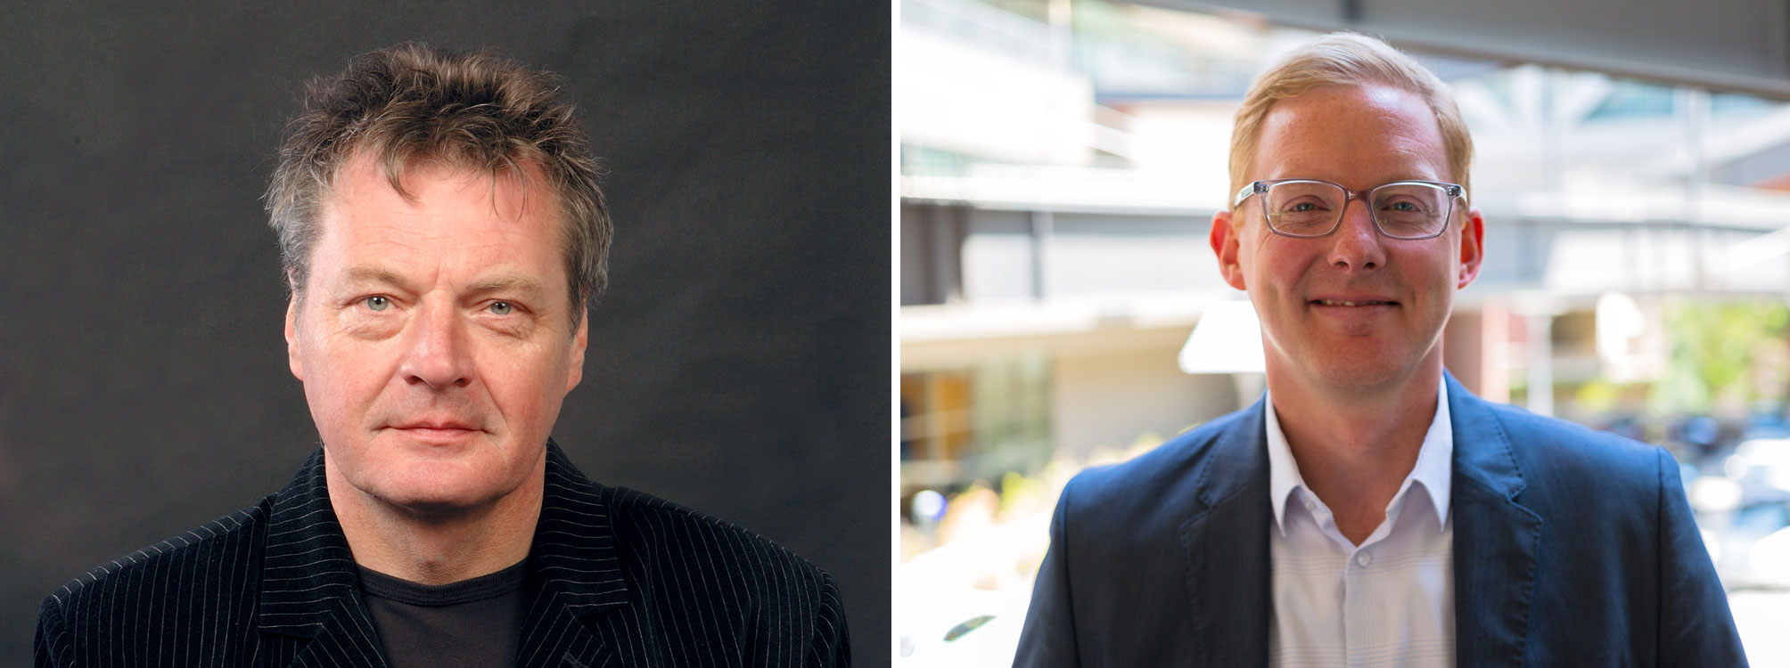
The Artificial Brain

Slide 32
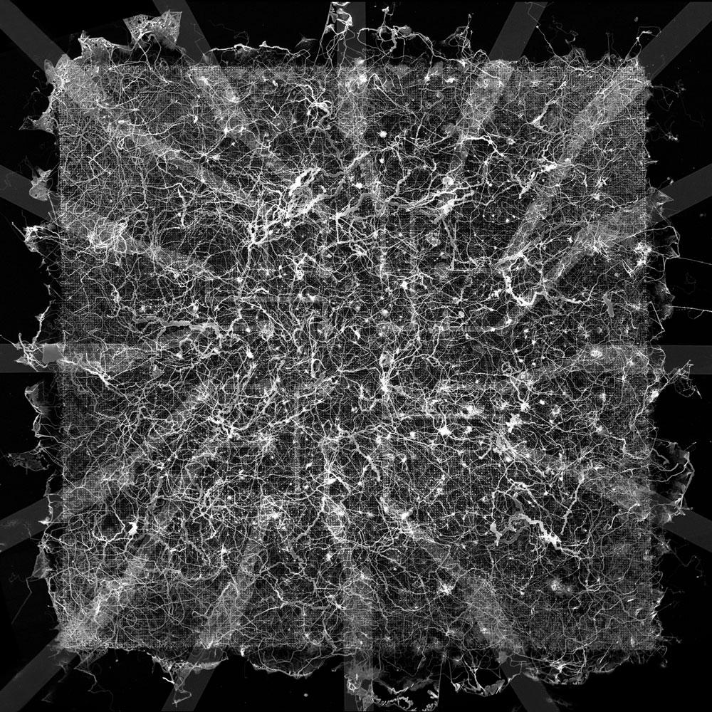
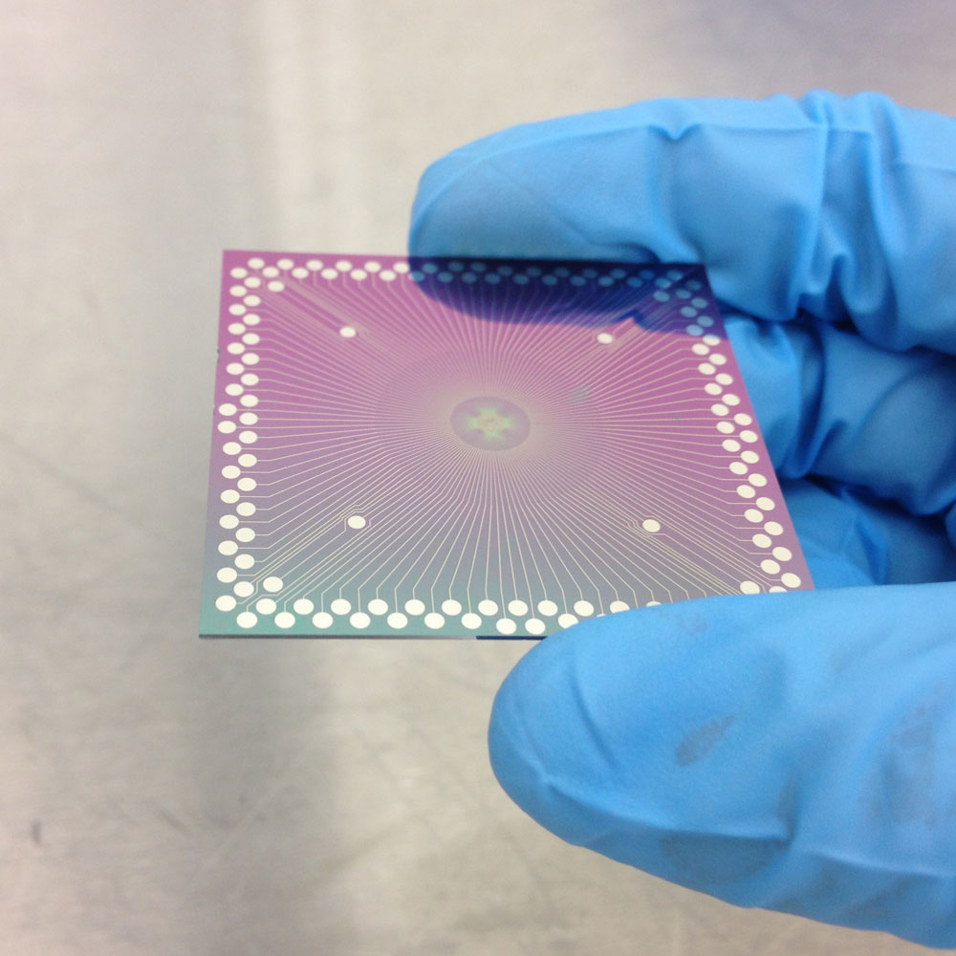
The Artificial Brain

